Slide 1
Oswald c
An Invitation to Graphs
The class notes are a compilation and edition from many sources. The faculty does not claim intellectual property or ownership of the lecture notes. Thanks to them!

Slide 2
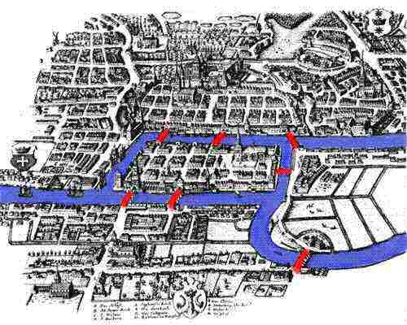

Konigsberg Bridge Problem
A
Rules
1.
2.
B
D
C
Notes:
Write the rules more formally
Start on any land mass
Cross each bridge once and only once
Can you do it?

Slide 3
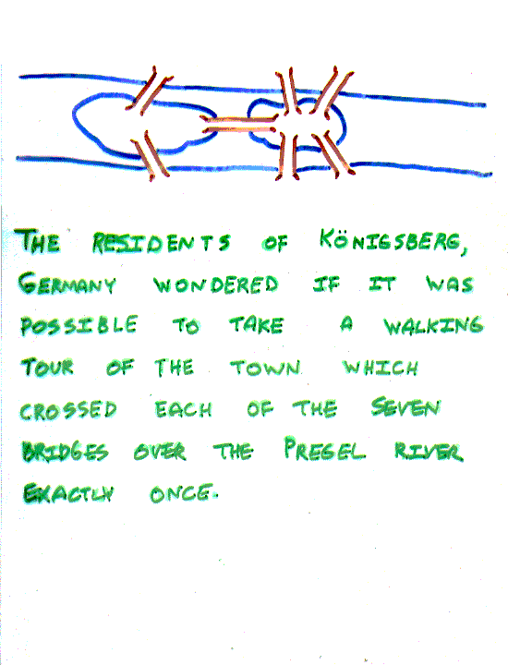
The Seven Bridges of Königsberg, Germany
The residents of Königsberg, Germany, wondered if it was possible to take a walking tour of the town that crossed each of the seven bridges over the Presel river exactly once. Is it possible to start at some node and take a walk that uses each edge exactly once, and ends at the starting node?

Slide 4
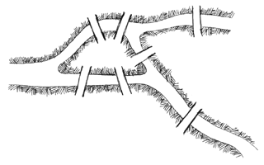
Your solution
Did it every time
Did it at least once
Can’t seem to do it
_{0 of 30}
Notes:
3

Slide 5
Konigsberg Bridge (8th bridge)
Notes:
Have student present solution.
Then make them start at an even vertex.

Slide 6
Your solution
Did it every time
Did it at least once
Can’t seem to do it
_{0 of 30}
Notes:
2

Slide 7
Konigsberg Bridge (9th bridge)

Slide 8
Your solution
Did it every time
Did it at least once
Can’t seem to do it
_{0 of 30}
Notes:
1

Slide 9
3 Cases for Konigsberg
Picture
7 Bridges (Non-traversable)
2. 8 Bridges (Euler Path)
3. 9 Bridges (Euler circuit)
Picture
Picture
Notes:
Define Euler Circuit (EC) etc. here

Slide 10
Euler’s View
Map
Graph
A
B
C
D
Notes:
Hand draw Euler's graph
What mathematicians do
Bring in clay: “donut = coffee cup”

Slide 11
The Seven Bridges of Königsberg, Germany (cont’d)
You can redraw the original picture as long as for every edge between nodes i and j in the original you put an edge between nodes i and j in the redrawn version (and you put no other edges in the redrawn version).
Original:
2
3
4
Redrawn:
2
4
1
3

Slide 12
The Seven Bridges of Königsberg, Germany (cont’d)
Has no solution that uses each edge exactly once.
(Even if we allow the walk to start and finish in different places.)
Can you see why?

Slide 13
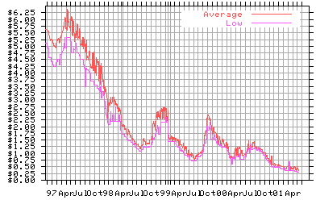
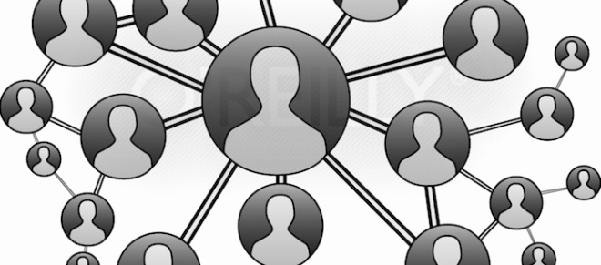
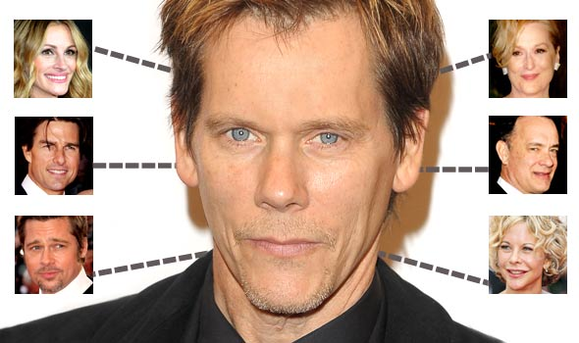
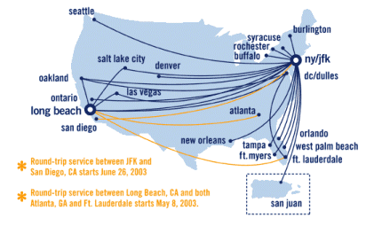
What is a graph?
56
Tokyo
Seattle
Paris
128
16
181
Pune
30
140
Delhi
Sydney

Slide 14
Definition
A graph G consists of two sets
a finite, nonempty set of vertices V(G)
a finite, possible empty set of edges E(G)
G(V,E) represents a graph
An undirected graph is one in which the pair of vertices in a edge is unordered, (v0, v1) = (v1,v0)
A directed graph(digraph) is one in which each edge is a directed pair of vertices, <v0, v1> != <v1,v0>
tail
head

Slide 15
Examples for Graph
0
0
0
1
2
1
2
1
3
3
4
5
6
G1
2
G2
complete graph
G3
G₂-incomplete graph
G₃- Incomplete and directed Graph
V(G1)={0,1,2,3} E(G1)={(0,1),(0,2),(0,3),(1,2),(1,3),(2,3)}
V(G2)={0,1,2,3,4,5,6} E(G2)={(0,1),(0,2),(1,3),(1,4),(2,5),(2,6)}
V(G3)={0,1,2} E(G3)={<0,1>,<1,0>,<1,2>}

Slide 16
Graphs: History
Texts typically trace the origin of graph theory to the Königsberg Bridge Problem and its solution by Leonhard Euler (the book gives this solution a date of 1736). The book describes the problem and the history behind it. You may recall that Euler (pronounced “oiler”) was a brilliant mathematician and perhaps the most prolific of history, remaining productive into his 70’s or 80’s despite going blind.

Slide 17
Graphs: Applications
One application of graphs is towards printed circuit and microchip design.
Graphs seem an intuitively natural way to model many situations in the Creation (connections of wires/leads, logistics/transportation problems, pipelines between points with known capacities, family trees, organizational charts, among many more).
This suggests why graph theory has grown so dramatically in the past century.
Examples
The internet: webpages are represented as nodes and the hyperlinks between those sites are represented as edges.
Social Networks: each person is represented as a vertex, and the edges could represent the friendships between the individuals.

Slide 18
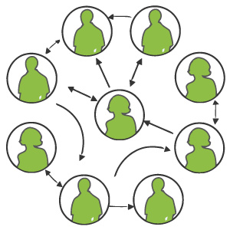
Some Graphs
For each example, what are the vertices and what are the edges?
Web pages with links
Facebook friends
"Input data" for the Kevin Bacon game
Methods in a program that call each other
Road maps
Airline routes
Family trees
Course pre-requisites
Core algorithms that work across such domains is why we are CSE

Slide 19
Scratching the Surface
Graphs are a powerful representation and have been studied deeply
Graph theory is a major branch of research in combinatorics and discrete mathematics
Every branch of computer science involves graph theory to some extent

Slide 20
Graph Terminology
To make formulating graphs easy and standard, we have a lot of standard terminology for graphs

Slide 21








Common Graphs
Complete Graph
There is an edge for every two vertices
Empty Graph
There is no edges between vertices
$$v_{4}$$
$$v_{1}$$
$$v_{2}$$
$$v_{3}$$
$$v_{4}$$
$$v_{1}$$
$$v_{2}$$
$$v_{3}$$

Slide 22








Common Graphs
Line Graph
Edges are in sequence
Cyclic Graph
Line graph that starts and ends at the same vertex.
$$v_{4}$$
$$v_{1}$$
$$v_{2}$$
$$v_{3}$$
$$v_{4}$$
$$v_{1}$$
$$v_{2}$$
$$v_{3}$$

Slide 23
Trees as Graphs
When talking about graphs, we say a tree is a graph that is:
undirected
acyclic
connected
All trees are graphs, but NOT all graphs are trees
How does this relate to the trees we know and "love"?
D
E
B
A
C
F
G
H

Slide 24
Degree
The degree of a vertex is the number of edges incident to that vertex
For directed graph,
the in-degree of a vertex v is the number of edges that have v as the head
the out-degree of a vertex v is the number of edges that have v as the tail
if di is the degree of a vertex i in a graph G with n vertices and e edges, the number of edges is

Slide 25
undirected graph
degree
3
0
0
2
1
2
3
1
2
3
3
3
3
4
5
6
3
3
1
G1
1
G2
1
1
0
in:1, out: 1
directed graph
in-degree
out-degree
1
in: 1, out: 2
2
in: 1, out: 0
G3

Slide 26
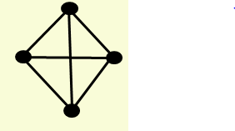
This graph has
6 edges, 4 vertices (exactly 2 of which are odd)
4 edges, 6 vertices (all of which are odd)
6 edges, 4 vertices (all of which are odd)
4 edges, 4 vertices (exactly 2 of which are odd)
_{0 of 30}
Notes:
4

Slide 27
Draw a graph with
4 vertices (all odd) and 5 edges
4 vertices (all odd) and 3 edges (no loops)
Notes:
The “reverse” problem – frequently asked in mathematics
Box with both diagonals
Paw print

Slide 28
Examples Again
Which would use directed edges?
Which would have self-edges?
Which could have 0-degree nodes?
Web pages with links
Facebook friends
"Input data" for the Kevin Bacon game
Methods in a program that call each other
Road maps
Airline routes
Family trees
Course pre-requisites

Slide 29
Weighted Graphs
In a weighted graph, each edge has a weight or cost
Typically numeric (ints, decimals, doubles, etc.)
Orthogonal to whether graph is directed
Some graphs allow negative weights; many do not
Clinton
20
Mukilteo
Kingston
30
Edmonds
Bainbridge
35
Seattle
60
Bremerton

Slide 30
Examples Again
Which would use directed edges?
Which would have self-edges?
Which could have 0-degree nodes?
Web pages with links
Facebook friends
"Input data" for the Kevin Bacon game
Methods in a program that call each other
Road maps
Airline routes
Family trees
Course pre-requisites

Slide 31
Subgraph and Path
A subgraph of G is a graph G’ such that V(G’) is a subset of V(G) and E(G’) is a subset of E(G)
A path from vertex vp to vertex vq in a graph G, is a sequence of vertices, vp, vi1, vi2, ..., vin, vq, such that (vp, vi1), (vi1, vi2), ..., (vin, vq) are edges in an undirected graph
The length of a path is the number of edges on it

Slide 32
Figure 6.4: subgraphs of G₁ and G₃
0
0
0
1
2
0
1
2
1
2
3
1
2
3
3
G1
(i) (ii) (iii) (iv)
(a) Some of the subgraph of G₁
0
0
0
0
0
1
1
1
1
2
2
2
(i) (ii) (iii) (iv)
(b) Some of the subgraph of G₃
G3

Slide 33
Simple Path and Style
A simple path is a path in which all vertices, except possibly the first and the last, are distinct
A cycle is a simple path in which the first and the last vertices are the same
In an undirected graph G, two vertices, v0 and v1, are connected if there is a path in G from v0 to v1
An undirected graph is connected if, for every pair of distinct vertices vi, vj, there is a path from vi to vj

Slide 34
connected
0
0
1
2
1
2
3
3
4
5
6
G1
G2
tree (acyclic graph)

Slide 35
ADT for Graph
structure Graph is
objects: a nonempty set of vertices and a set of undirected edges, where each edge is a pair of vertices
functions: for all graph ∈ Graph, v, v₁ and v₂ ∈ Vertices
Graph Create()::=return an empty graph
Graph InsertVertex(graph, v)::= return a graph with v inserted. v has no incident edge.
Graph InsertEdge(graph, v1,v2)::= return a graph with new edge between v1 and v2
Graph DeleteVertex(graph, v)::= return a graph in which v and all edges incident to it are removed
Graph DeleteEdge(graph, v1, v2)::=return a graph in which the edge (v1, v2) is removed
Boolean IsEmpty(graph)::= if (graph==empty graph) return TRUE
else return FALSE
List Adjacent(graph,v)::= return a list of all vertices that are adjacent to v

Slide 36
Graph Representations
Incidence (Matrix): Most useful when information about edges is more desirable than information about vertices.
Adjacency (Matrix/List): Most useful when information about the vertices is more desirable than information about the edges. These two representations are also most popular since information about the vertices is often more desirable than edges in most applications
Adjacency Multilists

Slide 37
Adjacency Matrix
Let G=(V,E) be a graph with n vertices.
The adjacency matrix of G is a two-dimensional n by n array, say adj_mat
If the edge (vi, vj) is in E(G), adj_mat[i][j]=1
If there is no such edge in E(G), adj_mat[i][j]=0
The adjacency matrix for an undirected graph is symmetric; the adjacency matrix for a digraph need not be symmetric

Slide 38
Representation- Adjacency Matrix
There is an N x N matrix, where |V| = N , the Adjacenct Matrix (NxN) A = [a_{ij}]
For undirected graph
For directed graph
This makes it easier to find subgraphs, and to reverse graphs if needed. The adjacency matrix for an undirected graph is symmetric; the adjacency matrix for a digraph need not be symmetric.

Slide 39
Examples for Adjacency Matrix
0
0
4
0
2
1
5
1
2
3
6
3
1
7
2
G2
G1
symmetric
undirected: n²/2
directed: n²
G4

Slide 40
Adjacency Matrix Properties
Running time to:
Get a vertex’s out-edges: O(|V|)
Get a vertex’s in-edges: O(|V|)
Decide if some edge exists: O(1)
Insert an edge: O(1)
Delete an edge: O(1)
Space requirements:
O(|V|²)
 | A | B | C | D
A | 0 | 1 | 0 | 0
B | 1 | 0 | 0 | 0
C | 0 | 1 | 0 | 1
D | 0 | 0 | 0 | 0

Slide 41
Representation- Incidence Matrix
G = (V, E) be an undirected graph. Suppose that v₁, v₂, v₃,…,v_{n} are the vertices and e₁, e₂,…,e_{m} are the edges of G. Then the incidence matrix with respect to this ordering of V and E is the n x m matrix M = [m _{ij}], where
Can also be used to represent :
Multiple edges: by using columns with identical entries, since these edges are incident with the same pair of vertices
Loops: by using a column with exactly one entry equal to 1, corresponding to the vertex that is incident with the loop

Slide 42
Representation- Incidence Matrix
Representation Example: G = (V, E)
 | e₁ | e₂ | e₃
v | 1 | 0 | 1
u | 1 | 1 | 0
w | 0 | 1 | 1
u
e1
e2
v
w
e3

Slide 43
Data Structures for Adjacency Lists
Each row in adjacency matrix is represented as an adjacency list.
#define MAX_VERTICES 50
typedef struct node *node_pointer;
typedef struct node {
int vertex;
struct node *link;
};
node_pointer graph[MAX_VERTICES];
int n=0; /* vertices currently in use */

Slide 44
0
0
4
2
1
5
1
2
3
6
3
7
0
1
2
3
1
2
3
0
1
2
3
4
5
6
7
1
2
0
2
3
0
3
0
1
3
0
3
0
1
2
1
2
G1
0
5
4
6
0
1
2
1
5
7
0
2
1
6
G3
G4
2

Slide 45
Adjacency List Properties
Running time to:
Get a vertex’s out-edges: O(d) where d is out-degree of vertex
Get a vertex’s in-edges: O(|E|) (could keep a second adjacency list for this!)
Decide if some edge exists: O(d) where d is out-degree of source
Insert an edge: O(1) (unless you need to check if it’s already there)
Delete an edge: O(d) where d is out-degree of source
Space requirements: O(|V|+|E|)

Slide 46
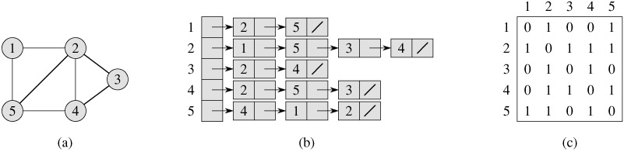
Graph representation – A small graph
Undirected
graph
Adjacency list
Adjacency matrix

Slide 47
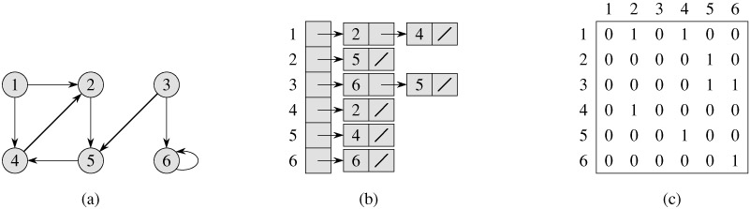
Graph representation – A small graph
Directed
graph
Adjacency list
Adjacency matrix

Slide 48
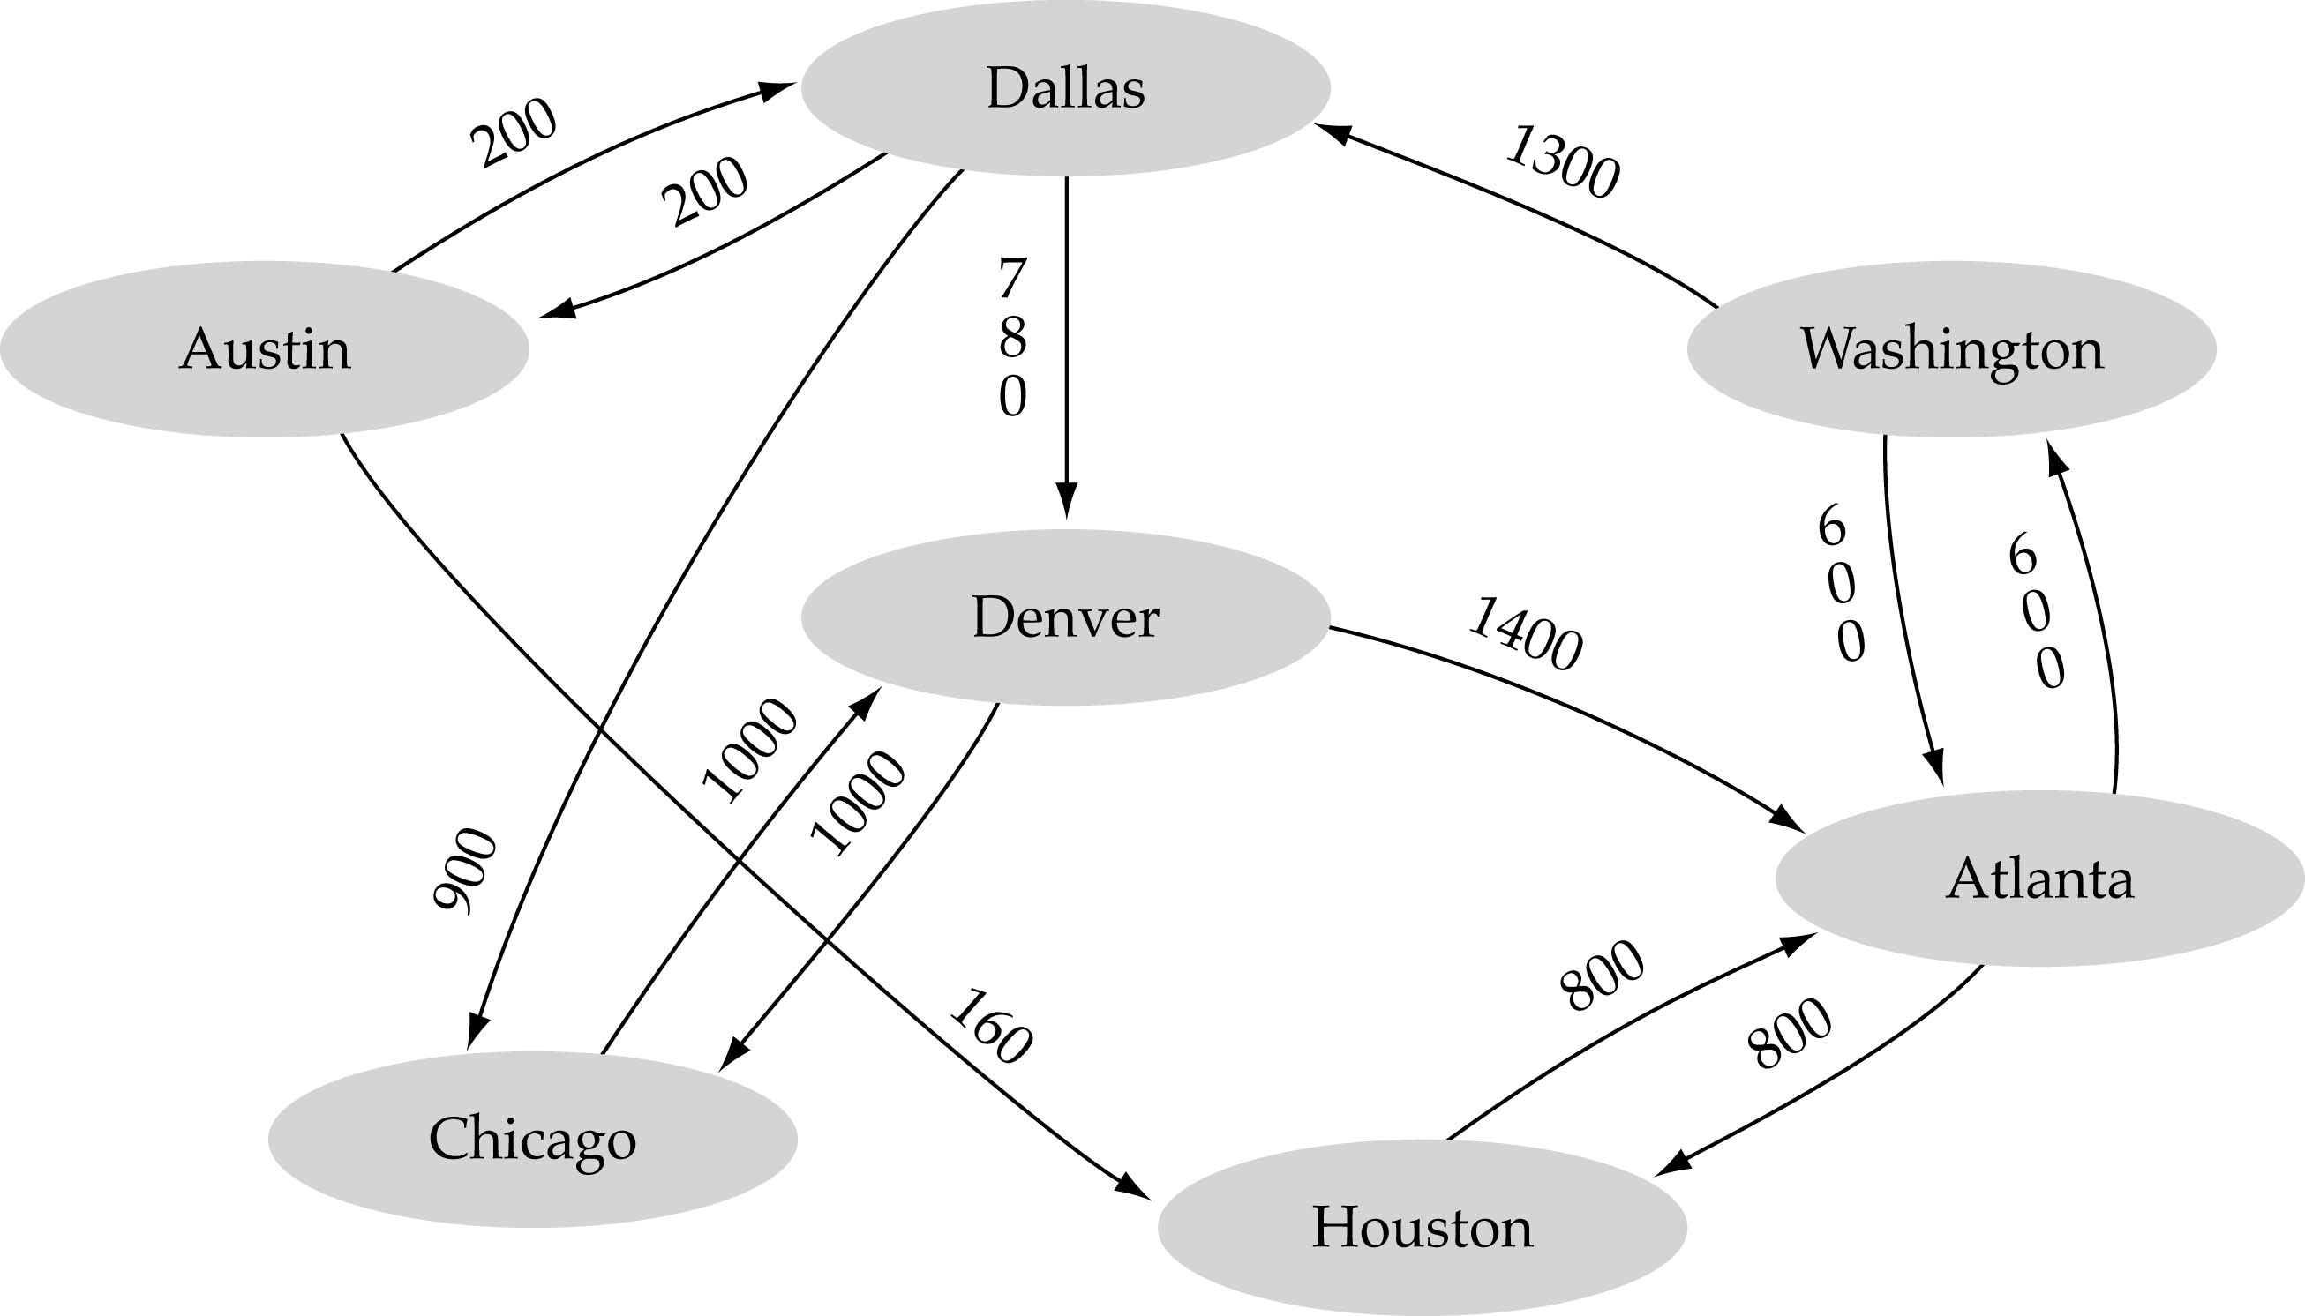
Graph Representation – A Large Graph
Array-based implementation
A 1D array is used to represent the vertices
A 2D array (adjacency matrix) is used to represent the edges

Slide 49
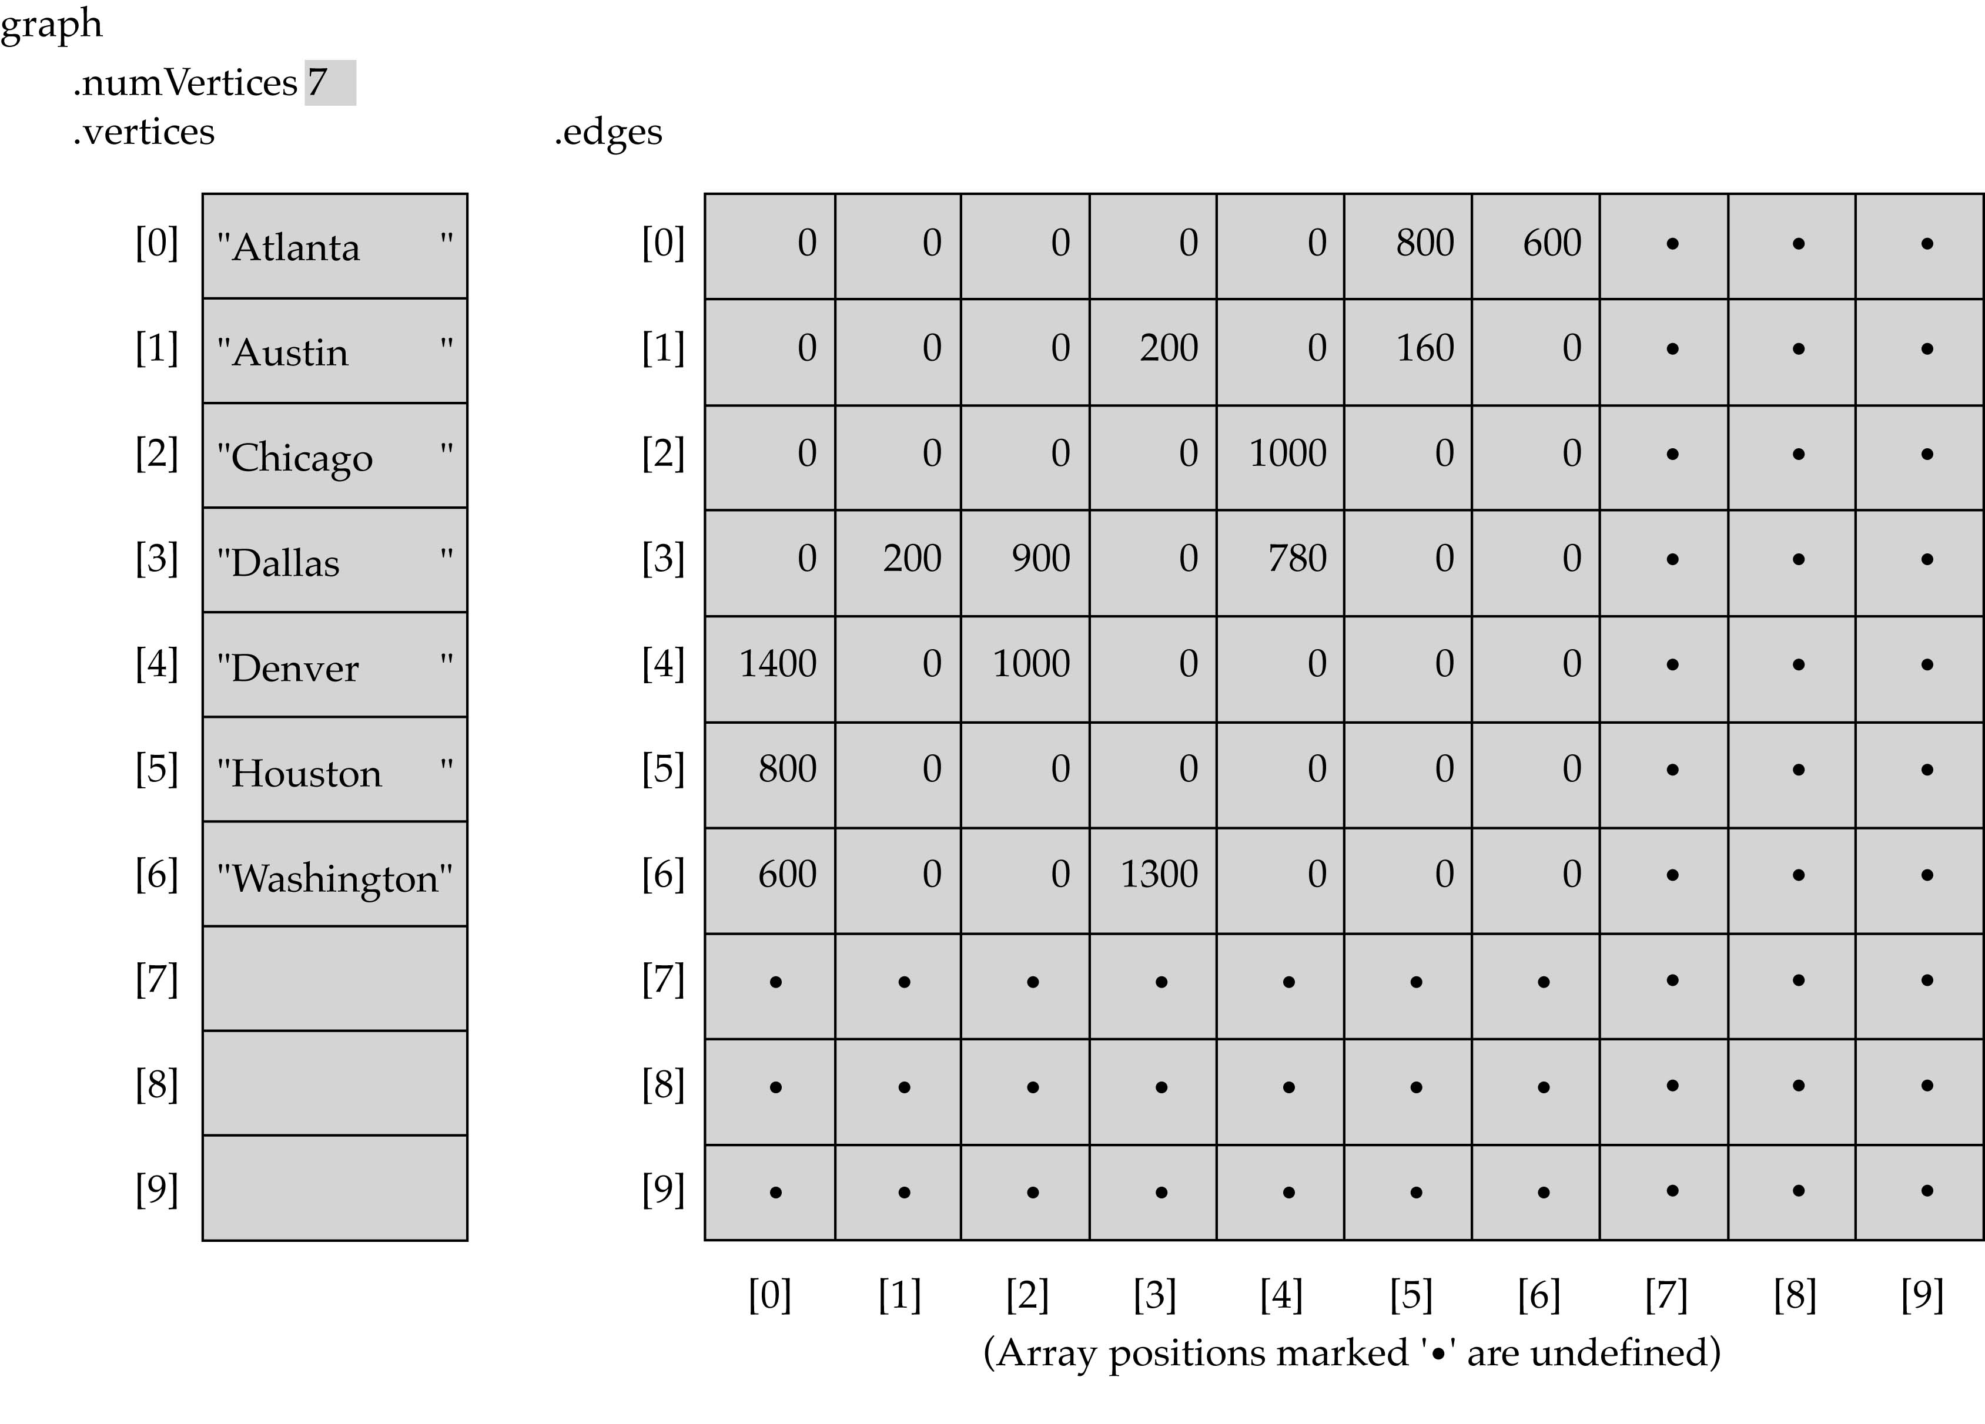
Graph Representation – A Large Graph

Slide 50
Graph Representation – A Large Graph
Linked-list implementation
A 1D array is used to represent the vertices
A list is used for each vertex v which contains the vertices which are adjacent from v (adjacency list)

Slide 51
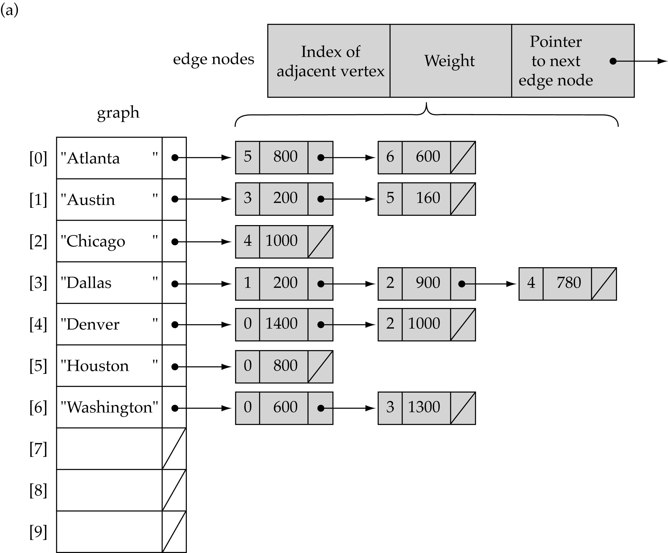
Graph Representation – A Large Graph-list implementation

Slide 52
Which is better?
Graphs are often sparse
Streets form grids
Airlines rarely fly to all cities
Adjacency lists should generally be your default choice
Slower performance compensated by greater space savings

Slide 53
Analysis - Adjacency matrix vs. adjacency list representation
Adjacency matrix
Good for dense graphs --|E|~O(|V|²)
Memory requirements: O(|V| + |E| ) = O(|V|² )
Connectivity between two vertices can be tested quickly
Adjacency list
Good for sparse graphs -- |E|~O(|V|)
Memory requirements: O(|V| + |E|)=O(|V|)
Vertices adjacent to another vertex can be found quickly

Slide 54
Impln. based on adjacency matrix representation
const int NULL_EDGE = 0;
template<class VertexType>
class GraphType {
public:
GraphType(int);
~GraphType();
void MakeEmpty();
bool IsEmpty() const;
bool IsFull() const;
void AddVertex(VertexType);
void AddEdge(VertexType, VertexType, int);
int WeightIs(VertexType, VertexType);
void GetToVertices(VertexType, QueType<VertexType>&);
void ClearMarks();
void MarkVertex(VertexType);
bool IsMarked(VertexType) const;
private:
int numVertices;
int maxVertices;
VertexType* vertices;
int **edges;
bool* marks;
};
(continues)

Slide 55
template<class VertexType>
GraphType<VertexType>::GraphType(int maxV)
{
numVertices = 0;
maxVertices = maxV;
vertices = new VertexType[maxV];
edges = new int[maxV];
for(int i = 0; i < maxV; i++)
edges[i] = new int[maxV];
marks = new bool[maxV];
}
template<class VertexType>
GraphType<VertexType>::~GraphType()
{
delete [] vertices;
for(int i = 0; i < maxVertices; i++)
delete [] edges[i];
delete [] edges;
delete [] marks;
}
(continues)

Slide 56
void GraphType<VertexType>::AddVertex(VertexType vertex)
{
vertices[numVertices] = vertex;
for(int index = 0; index < numVertices; index++) {
edges[numVertices][index] = NULL_EDGE;
edges[index][numVertices] = NULL_EDGE;
}
numVertices++;
}
template<class VertexType>
void GraphType<VertexType>::AddEdge(VertexType fromVertex,
VertexType toVertex, int weight)
{
int row;
int column;
row = IndexIs(vertices, fromVertex);
col = IndexIs(vertices, toVertex);
edges[row][col] = weight;
}
(continues)

Slide 57
template<class VertexType>
int GraphType<VertexType>::WeightIs(VertexType fromVertex,
VertexType toVertex)
{
int row;
int column;
row = IndexIs(vertices, fromVertex);
col = IndexIs(vertices, toVertex);
return edges[row][col];
}

Slide 58
Interesting Operations
degree of a vertex in an undirected graph
# of nodes in adjacency list
# of edges in a graph
determined in O(n+e)
out-degree of a vertex in a directed graph
# of nodes in its adjacency list
in-degree of a vertex in a directed graph
traverse the whole data structure

Slide 59
Few References
[1]“6.042J Chapter 5: Graph theory - MIT6_042JF10_chap05.pdf.” [Online]. Available: http://ocw.mit.edu/courses/electrical-engineering-and-computer-science/6-042j-mathematics-for-computer-science-fall-2010/readings/MIT6_042JF10_chap05.pdf. [Accessed: 28-Aug-2013].
[2] reading: Weiss Ch. 9.
[3] Data structures with C++ using STL by Ford, William; Topp, William; Prentice Hall.
[4] Introduction to Algorithms by Cormen, Thomas et. al., The MIT press.

